Slide 1
Deconvolution
Tom Vettenburg
<tom.vettenburg@uc3m.es>

Slide 2
Why deconvolution?
Reverse blur caused by the imaging process.
improve sharpness
suppress noise
Certainly needed when blur explicitly introduced
What not?
improve signal to noise ratio

Slide 3

Convolution
imaging process ≈ convolution
of what we want to know, f(r), with a blur function, g(r), the PSF.
source: Wikipedia.org

Slide 4
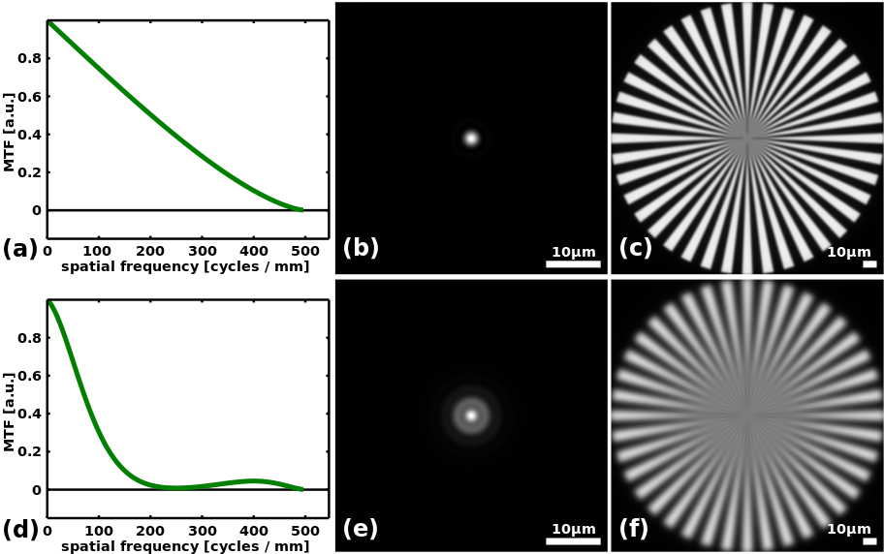
Convolution
imaging process ≈ convolution
of what we want to know, f(r), with a blur function, g(r), the PSF.
I_{image}(r) = I_{object}(r) * PSF(r)
= *

Slide 5
Convolution
imaging process ≈ convolution
of what we want to know, f(r), with a blur function, g(r), the PSF.
I_{image}(r) = I_{object}(r) * PSF(r)
= *

Slide 6
Convolution
imaging process ≈ convolution
of what we want to know, f(r), with a blur function, g(r), the PSF.
I_{image}(r) = I_{object}(r) * PSF(r)
= *

Slide 7
(de)convolution?
we
measure
this
we want
to know
this
I_{image}(r) = I_{object}(r) * PSF(r)
= *

Slide 8
(de)convolution?
we
may
know
this
we
measure
this
we want
to know
this
I_{image}(r) = I_{object}(r) * PSF(r)
= *

Slide 9
(de)convolution?
we
may
know
this
we
measure
this
we want
to know
this
I_{image}(r) = I_{object}(r) * PSF(r)
{I_{image}(r)} = {I_{object}(r)}. {PSF(r)}
The convolution theorem:

Slide 10
(de)convolution?
we
may
know
this
we
measure
this
we want
to know
this
complex
argument
not shown
I_{image}(r) = I_{object}(r) * PSF(r)
{I_{image}(r)} = {I_{object}(r)}. OTF(r)
or I_{image}(r) = { {I_{object}(r)}.OTF(r)}
Opt. Transf. Func. OTF(r) = {PSF(r)}
(typically the total intensity in the PSF is normalized)

Slide 11
(de)convolution?
Can’t we just divide by the OTF?
{I_{image}(r)} = {I_{object}(r)}.OTF(r)
{ {I_{image}(r)}/OTF(r)} = I_{object}(r)

Slide 12
(de)convolution?
Can’t we just divide by the OTF?
{I_{image}(r)} = {I_{object}(r)}.OTF(r)
{ {I_{image}(r)}/OTF(r)} = I_{object}(r)
In principle, just be careful with division by zero,
or anything below the noise level really…

Slide 13
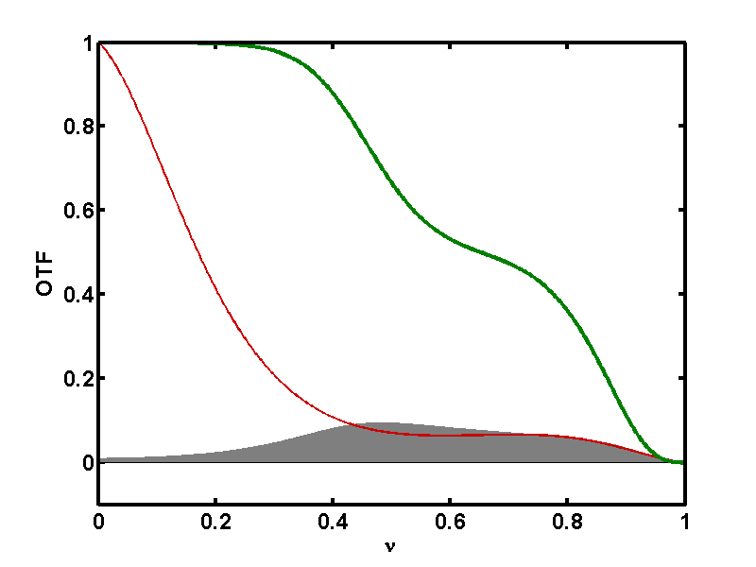
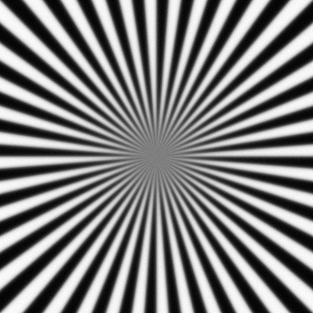
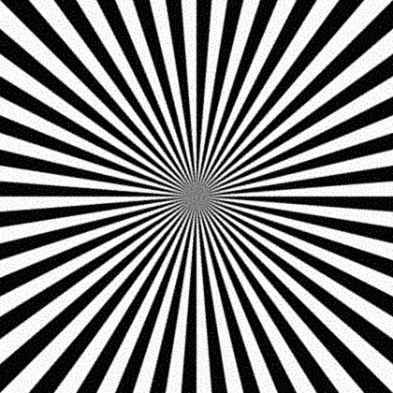
(de)convolution?
Can’t we just divide by the OTF?
{I_{image}(r)} = {I_{object}(r)}.OTF(r)
{ {I_{image}(r)}/OTF(r)} = I_{object}(r)
Better divide by OTF(r)+something, e.g. using Wiener filter: H_{w}(r) =
OTF(r)*
|OTF(r)|²+|N/S|²

Slide 14
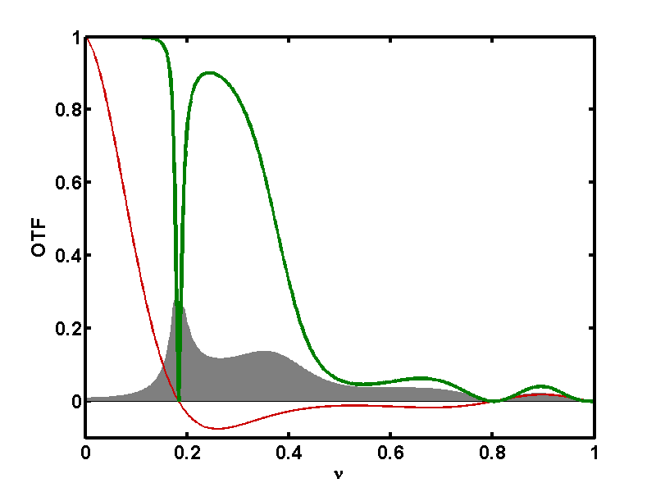
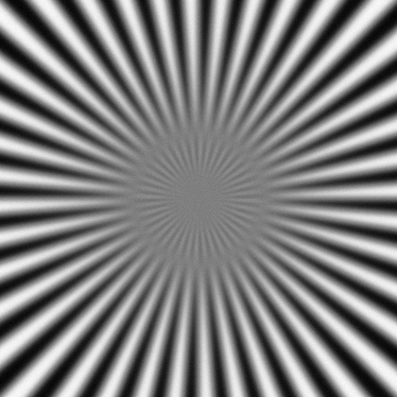
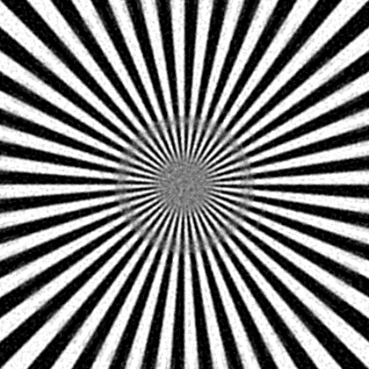
Image sharpening by devonvolution
zero contrast cannot be recovered!
note: phase inversal is possible
at some spatial frequencies for some aberrations.
|OTF|
|OTF.H_{w}|
noise
acquired
restored

Slide 15
Resources and Further Reading
https://en.wikipedia.org/wiki/Optical_transfer_function
https://en.wikipedia.org/wiki/Convolution_theorem
https://svi.nl/HuygensDeconvolution#Image_formation

